Slide 1
SENG2260 Human-Computer Interaction
Week 10: Evaluation: Inspections, Analytics & Models
All images in this presentation are either licenced or labelled for reuse on Google Images.

Slide 2


Chapter 15
Evaluation: Inspections, Analytics & Models
Chapter 16
Evaluation: Inspections, Analytics & Models

Slide 3
Aims:
Describe the key concepts associated with inspection methods.
Explain how to do heuristic evaluation and walkthroughs.
Explain the role of analytics in evaluation.
Describe how to use Fitts’ Law – a predictive model.
Notes:
3

Slide 4
Inspections
Several kinds.
Experts use their knowledge of users & technology to review software usability.
Expert critiques can be formal or informal.
Heuristic evaluation is a review guided by a set of heuristics.
Walkthroughs involve stepping through a pre-planned scenario noting potential problems.
Notes:
4

Slide 5
Heuristic evaluation
Developed by Jacob Nielsen in the early 1990s.
Based on heuristics distilled from an empirical analysis of 249 usability problems.
These heuristics have been revised for current technology by Nielsen and others for:
mobile devices,
wearables,
virtual worlds,
social media etc.
Design guidelines form a basis for developing heuristics.
Notes:
5

Slide 6
Revised version (2014) of Nielsen’s original heuristics
Visibility of system status.
Match between system and real world.
User control and freedom.
Consistency and standards.
Error prevention.
Recognition rather than recall.
Flexibility and efficiency of use.
Aesthetic and minimalist design.
Help users recognize, diagnose, recover from errors.
Help and documentation.
Notes:
6

Slide 7
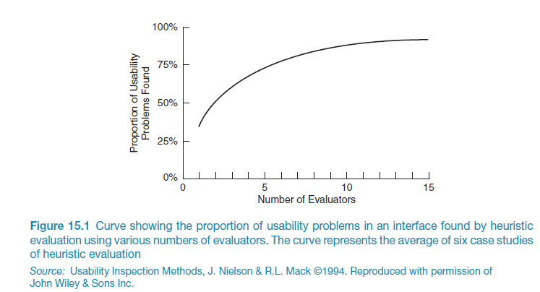
No. of evaluators & problems
Notes:
7

Slide 8
Number of evaluators
Nielsen suggests that on average 5 evaluators identify 75-80% of usability problems.
Cockton and Woolrych (2001) point out that the number of users needed to find 75-80% of usability problems depends on the context and nature of the problems.
Notes:
8

Slide 9
Heuristics for websites focus on key criteria (Budd, 2007)
Clarity
Minimize unnecessary complexity & cognitive load
Provide users with context
Promote positive & pleasurable user experience

Slide 10
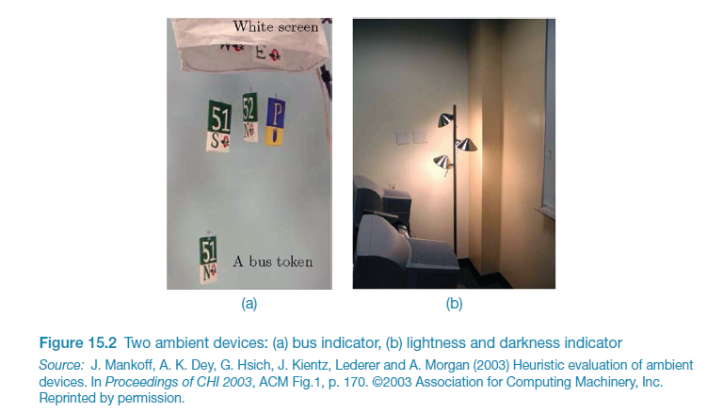
Using heuristics to evaluate to evaluate ambient displays

Slide 11
Using heuristics to evaluate to evaluate ambient displays
What new heuristics??

Slide 12
Using heuristics to evaluate to evaluate ambient displays
Visibility of state
Peripherality of display

Slide 13
Three stages for doing heuristic evaluation
Briefing session to tell experts what to do.
Evaluation period of 1-2 hours in which:
Each expert works separately;
Take one pass to get a feel for the product;
Take a second pass to focus on specific features.
Debriefing session in which experts work together to prioritize problems.
Notes:
13

Slide 14
Advantages and problems
Few ethical & practical issues to consider because users not involved.
Can be difficult & expensive to find experts.
Best experts have knowledge of application domain & users.
Biggest problems:
Important problems may get missed;
Many trivial problems are often identified;
Experts have biases.
Notes:
14

Slide 15
Turning design guidelines and golden rules into heuristics
Ask questions like the following:
“Does the application include a visible title page, section or site? Does the user always know where they are located? Does the user always know what the system or application is doing? Are the links clearly defined? Can all actions be visualized directly (i.e., no other actions are required)?”
Granollers, 2018, p. 62
Notes:
15

Slide 16
Evaluating for accessibility using Guidelines
Web Content Accessibility Guidelines (WCAG) (see Lazar et al., 2015).
Guidelines can be used as heuristics for evaluating websites.
Governments and large corporations have to make their websites accessible by law.
Four key concepts:
Perceivable;
Operable;
Understandable;
Robust.
https://www.w3.org/WAI/standards-guidelines/wcag/glance/
Notes:
16

Slide 17
Cognitive walkthroughs
Focus on ease of learning.
Designer presents an aspect of the design & usage scenarios.
Expert is told the assumptions about user population, context of use, task details.
One or more experts walk through the design prototype with the scenario.
Experts are guided by 3 questions.
Notes:
17

Slide 18
The 3 questions
Will the correct action be sufficiently evident to the user?
Will the user notice that the correct action is available?
Will the user associate and interpret the response from the action correctly?
As the experts work through the scenario they note problems.
Notes:
18

Slide 19
Pluralistic walkthrough
Variation on the cognitive walkthrough theme.
Performed by a carefully managed team.
The panel of experts begins by working separately.
Then there is managed discussion that leads to agreed decisions.
The approach lends itself well to participatory design.
Also other adaptations of basic cognitive walkthroughs.
Notes:
19

Slide 20
Web Analytics
A form of interaction logging that analyzes users’ activities on website.
Designers use the analysis to improve their designs.
When designs don’t meet users’ needs they will not return to the site.
They become one-time users
Web analytics enable designers to track the activities of users on their site.
They can see how many people come to the site, how long they stay and where they go.
Web analytics offer designers the “big picture” about how their site performs based on user activity.
One of the most well-know analytics.
Notes:
20

Slide 21
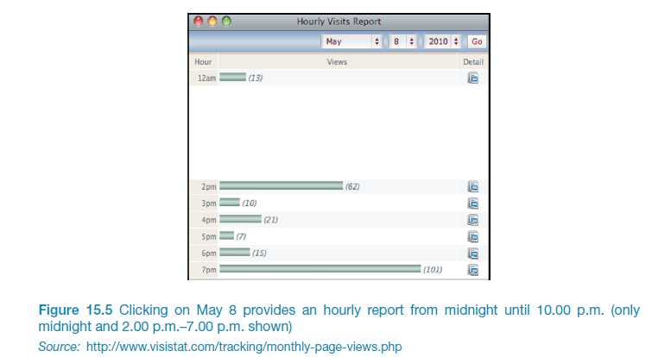
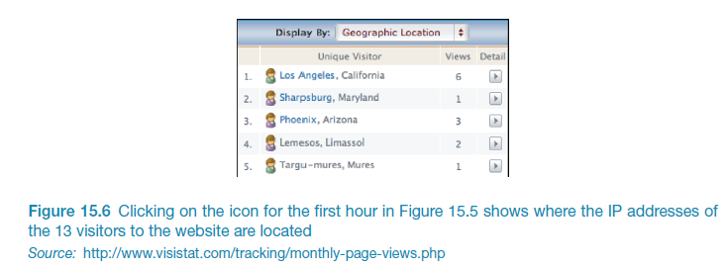
Evaluation using analytics
A method for evaluating user traffic through a system or part of a system.
Many examples: Google Analytics (lecture 7), Visistat (shown here), Learning Analytics.
Times of day & visitor IP addresses

Slide 22
Segment of Google Analytics for id-book.com, December 2018

Slide 23
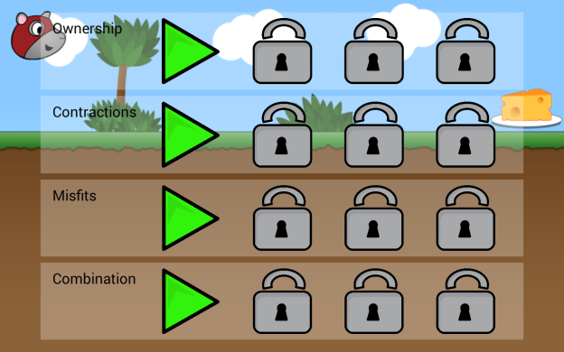

Slide 24
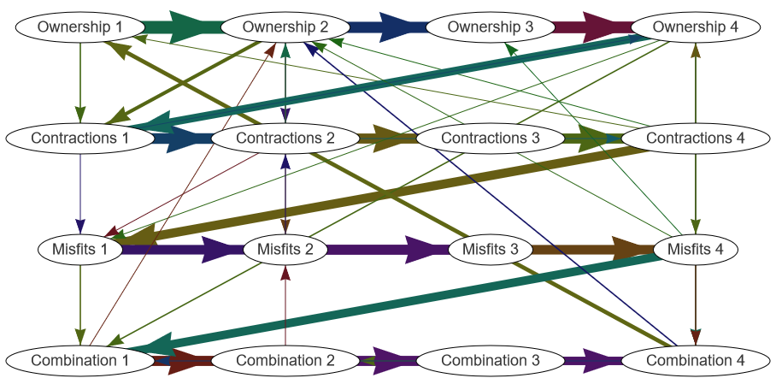

Slide 25
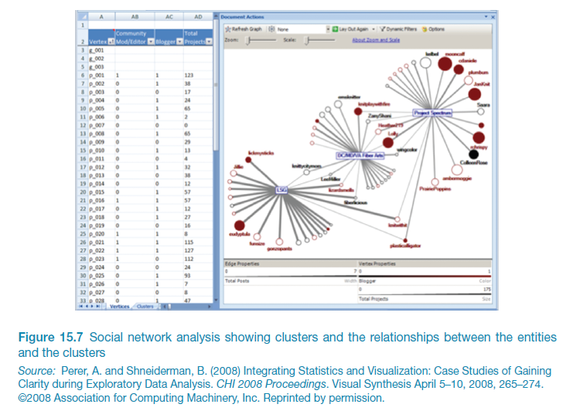
Social action analysis (Perer & Shneiderman, 2008)

Slide 26
A/B Testing
A large-scale experiment.
Offers another way to evaluate a website, application of app running on a mobile device.
Often used for evaluating changes in design on social media applications.
Compares how two groups of users perform on two versions of a design.
Can involve thousands of users.
May create ethical dilemmas if users don’t know they are part of the test.
Care is needed to ensure that other issues are not affecting users’ behavior.
Notes:
26

Slide 27
Predictive models
Provide a way of evaluating products or designs without directly involving users.
Less expensive than user testing.
Usefulness limited to systems with predictable tasks - e.g., telephone answering systems, mobiles, cell and smart phones.
Based on expert error-free behavior.
Notes:
27

Slide 28
Fitts’ Law (Fitts, 1954)
Fitts’ Law predicts that the time to point at an object using a device is a function of the distance from the target object & the object’s size.
The further away and the smaller the object, the longer the time to locate it and point to it.
Particularly useful for determining where on a screen to position an object.
Fitts’ Law is useful for evaluating systems for which the time to locate an object is important, e.g., a cell and smart phones, a handheld and mobile devices.
Notes:
28

Slide 29

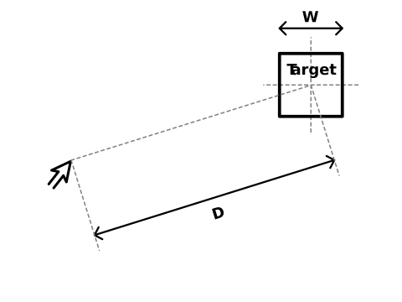

As a Predictive model
T = klog₂(D/S + 1.0)
T = time to move the pointer to a target
D = distance between the pointer and the target
S = size of the target
k is a constant of approx. 200 ms/bit
Original model
Index of performance (bits per second) = index of difficulty / movement time
Average information per movement by time per movement
Shannon formulation for HCI
The difficulty of a pointing task is equated to the quantity of information transmitted (in units of bits) by performing the task

Slide 30
Key points
Inspections can be used to evaluate requirements, mockups, functional prototypes, or systems.
User testing & heuristic evaluation may reveal different usability problems.
Design guidelines can be used to develop heuristics
• Walkthroughs are focused so are suitable for evaluating small parts of a product.
• Analytics involves collecting data about users activity on a website or product
• Fitts’ Law can be used to predict expert, error-free performance for clearly defined tasks with limited key presses, e.g. data entry and smart phone use.
Notes:
30

Slide 31
You should now...
Know the key concepts associated with inspection methods
Be aware of ways conduct heuristic evaluations and walkthroughs
Be able to discuss the role of analytics in evaluation
Describe the relevance and use of Fitts’ Law

